Slide 1
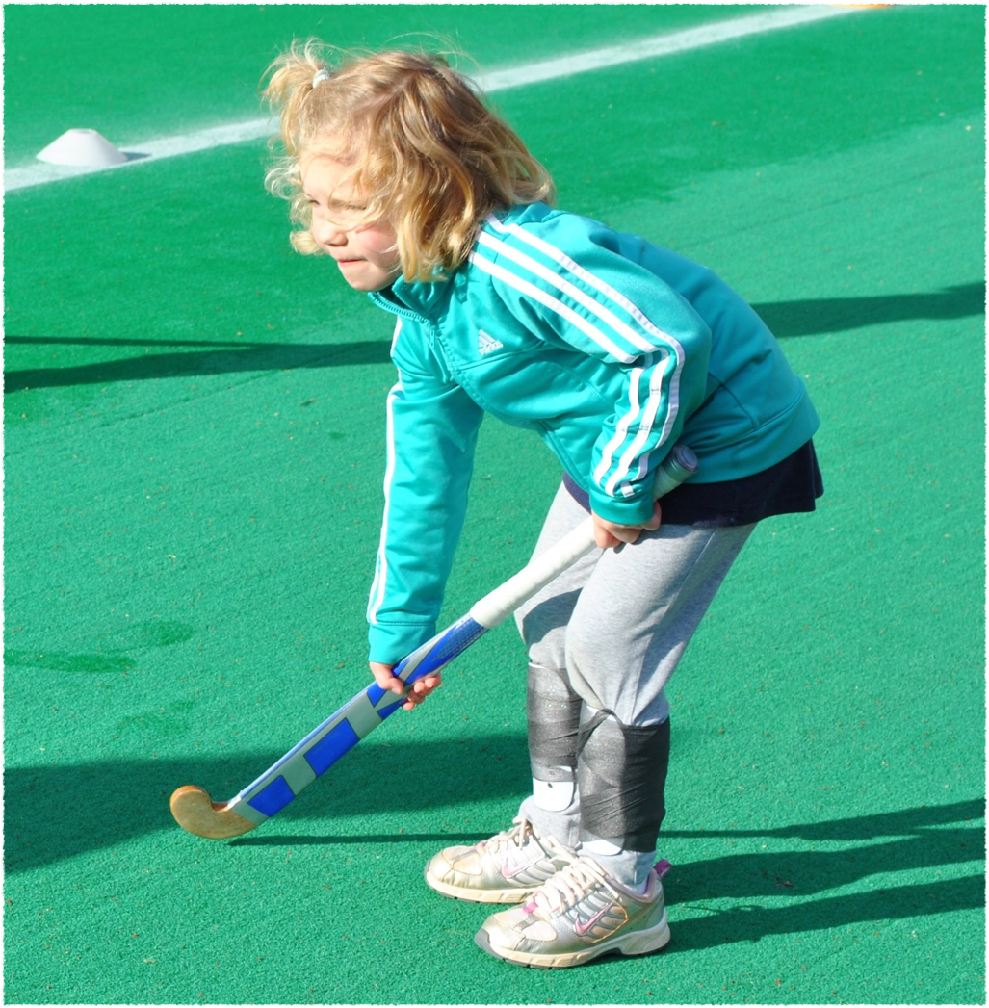
Developmental Hockey Programs for our Youth
Blueprint for development

Slide 2
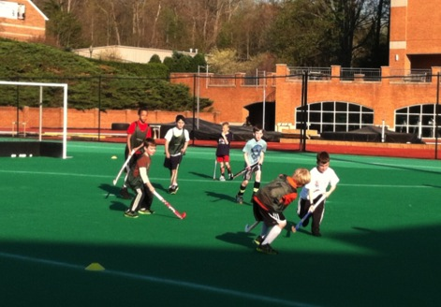
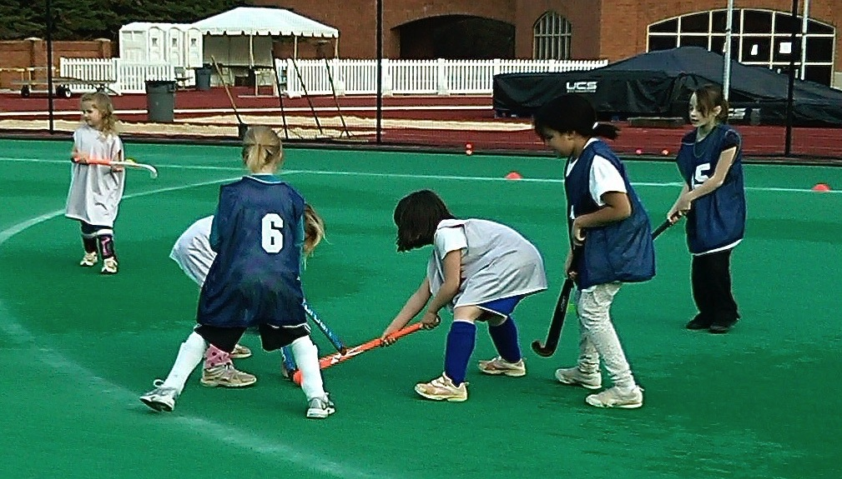
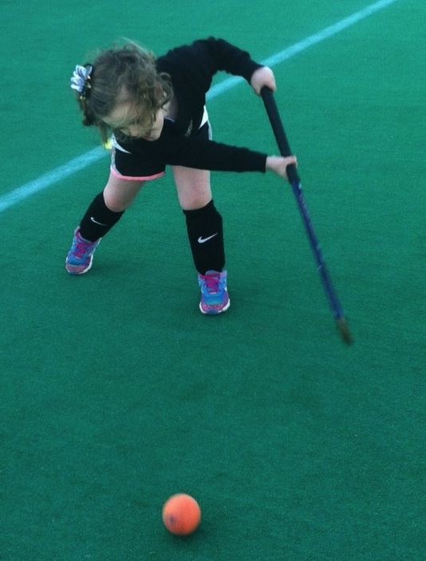
Weed Whackers

Slide 3
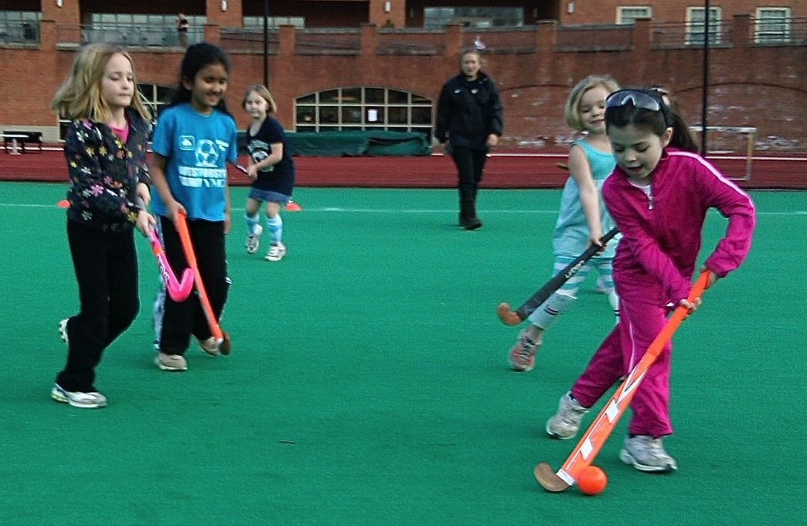
What is WeedWhackers?
Free, community-based field hockey program that began over 10 years ago because of the lack of hockey offered to young kids.

Slide 4
Why Do This?

Slide 5
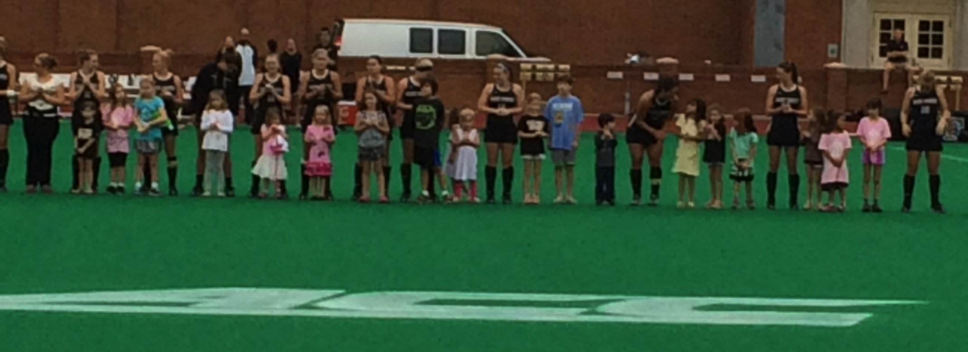
Youth hockey is the LIFELINE to our profession.
Our turf facilities are the surface for young players.
It is a way to give back to our communities.
Involved “outside of the box” teaching for coaching staff and players.
Helped players realize what it’s like to coach/teach.
It opens the door for ALL kids to play as there is no cost.
Notes:
- No playing facilities or coaches available to initiate such a program.
- It was also a way to give back to a community that had done so much for our University over the years.
- The coaching staff and players spend one hour per week training and teaching the sport.
-The cost of the program is free.

Slide 6
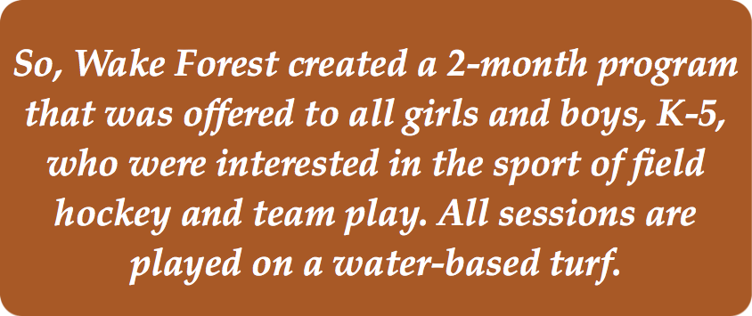

Slide 7
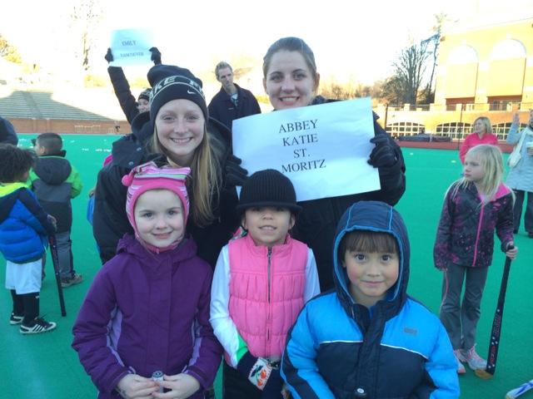
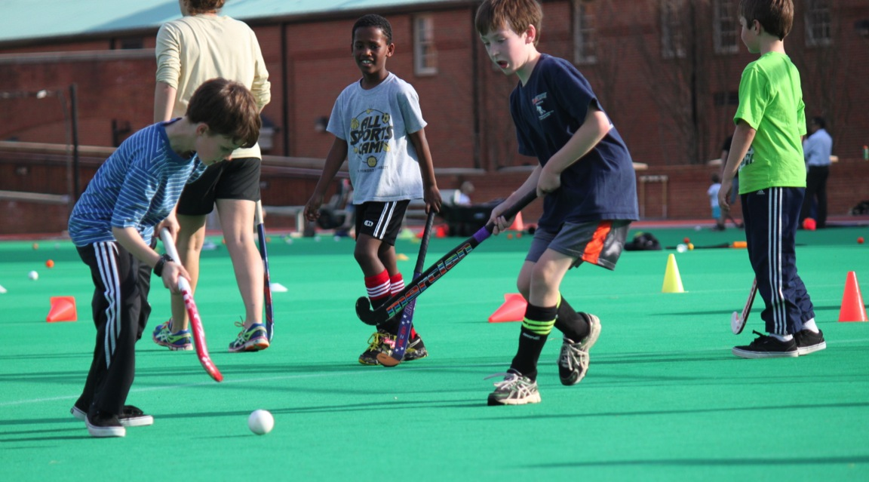
The Challenges
Getting started!
Soliciting a volunteer to be your Director of the program.
Finding a consistent day of the week for 8 weeks.
Providing bathrooms nearby.
Having patience with the little one’s.
Providing back up plans or alternate games for age groups.
Creating a fun environment first, then teach.
Notes:
Encourage college coaches and players to initiate a free volunteer-based program in community.
Little ones - limited attention span, so you always need to be creative. Its more about having fun than teaching hockey.

Slide 8
Management

Slide 9
Acts as liaison between coaches and parents.
Gathers information from parents and create worksheets for staff.
Stick size, gear, teams, etc.
Creates easy-to-read worksheets for staff.
Provides updates and logistical information to parents.
Attends every session to address concerns or problems.
Appoints one parent to be the “Parent Chair” if needed.
Coordinates end of the season party with Parent Chair.
Updates website with pertinent information.
Notes:
Retrieving all material and format into functional worksheets for the staff.
Liaison between coaches and parents.
Responsible for updates and logistical information to parents - includes weather,where to meet, which team child is playing on (many forget).
Attend every session for problem shooting - is stick size correct? is kid on proper team? is everyone having fun?
Appoint one parent to be the “Parent Chair” in case of need.
Coordinate end of the season party with Parent Chair.
Update website with pertinent information.
Weather updates.

Slide 10
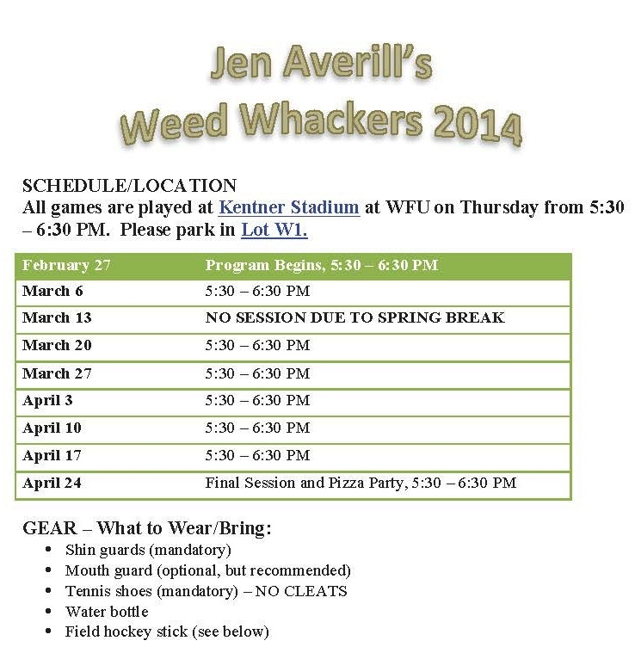

Slide 11
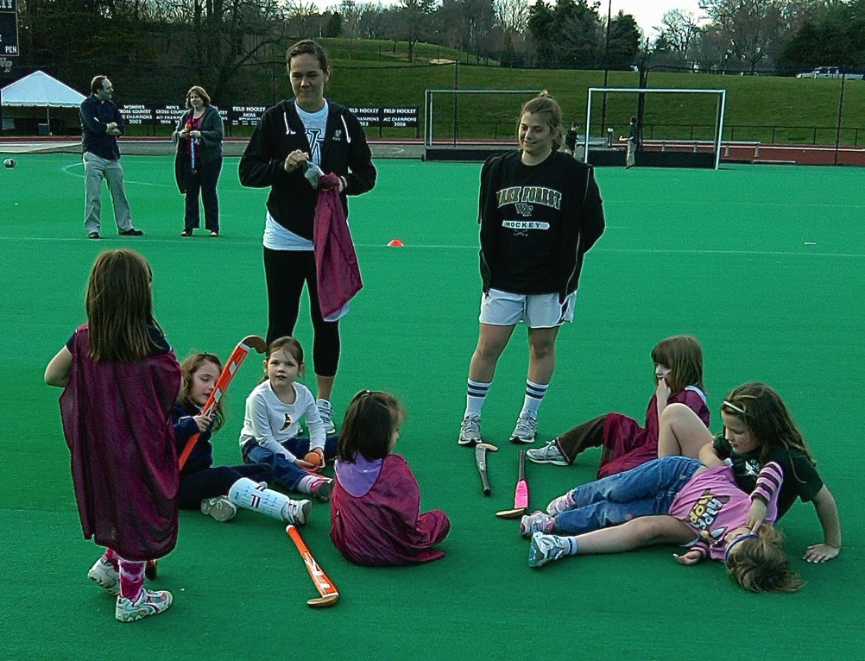
Meet with local High Schools.
Network on campus with faculty.
Find an 8 week period in your students schedule.
Develop Curriculum (age specific)
Set up fields.
Assign umpires.
Assign medical trainer.
Set up water stations.

Slide 12
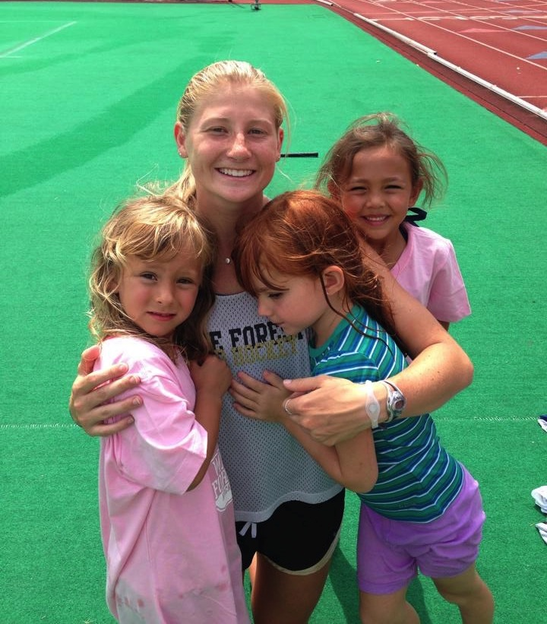
Reviews, understands and implements curriculum.
Develops age-appropriate warm up.
Brings energy to each session.
Is creative and flexible.
Listens to the Weed Whackers.

Slide 13
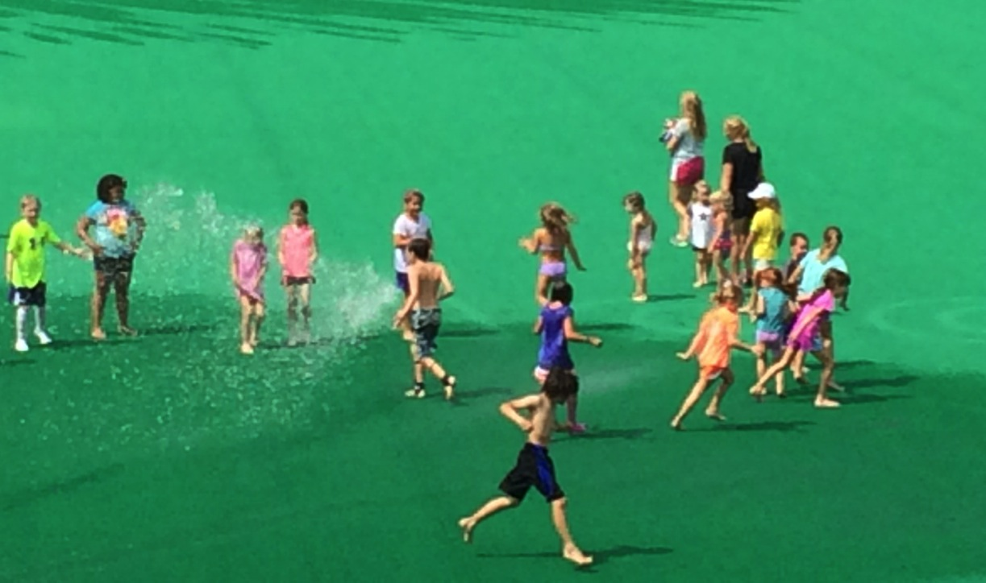
Have fun!
Be open to meeting new friends!
Dress warm and bring water.
Listen to your coaches.
Ask questions.
Notes:
Have fun
Be open to meeting new friends
Dress warm
Listen to your coaches
Ask questions

Slide 14
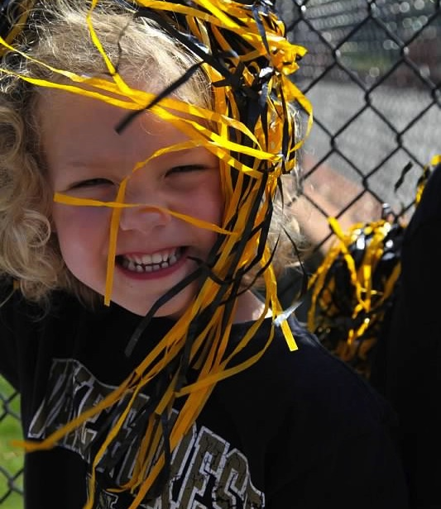
Game Plan
Advertise on your campus.
Visit with local elementary and charter schools.
Post on website.
Encourage local hockey enthusiasts to “spread the word”.
If you have kids, call upon their friends.
Notes:
Advertise on campus to all current faculty and staff
Visit with local elementary and nearby charter schools
Post on website
Create curriculum for age groups and talent level - each session should build on past session.
• Use a variety of balls for teaching - handballs for youngest players.
• Have safety and medical supplies available at all sessions
• Have water available
• Ask for feedback and listen to what the kids say, and what they enjoy doing

Slide 15
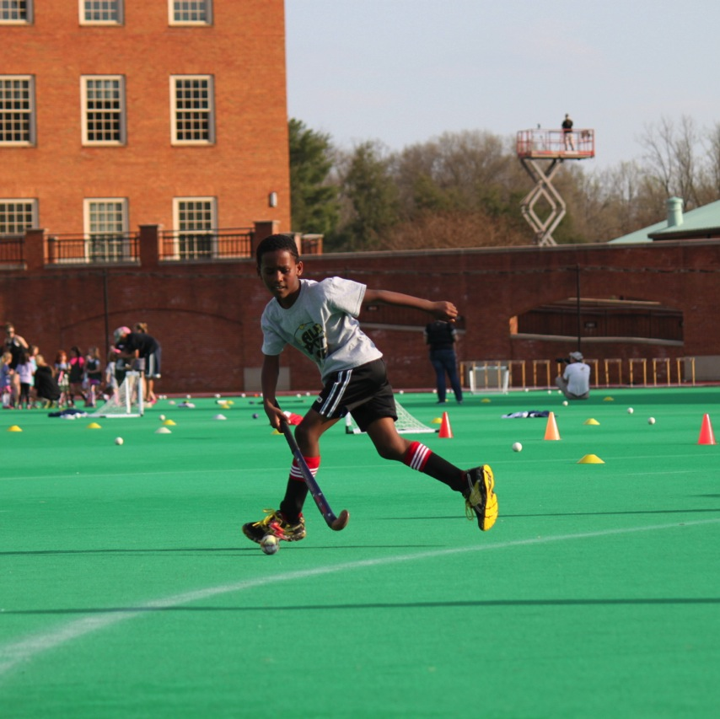
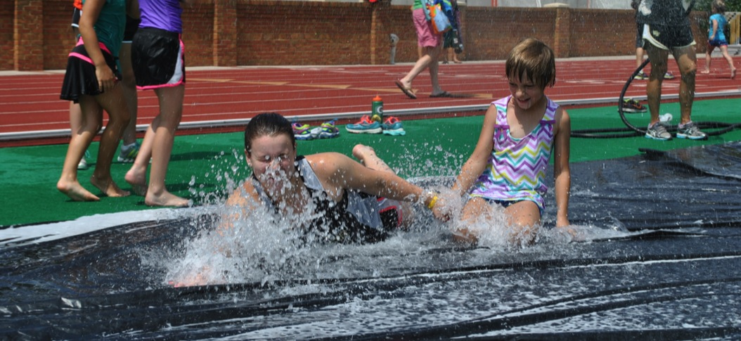
Game Plan
Create curriculum for all age groups and talent level.
Use a variety of balls for teaching.
Have safety and medical supplies available.
Provide water.
Ask for feedback and LISTEN to what the kids suggest.

Slide 16
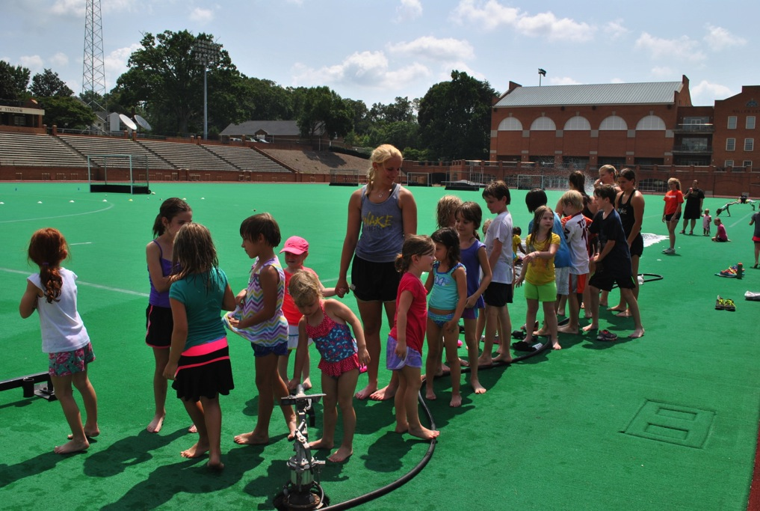
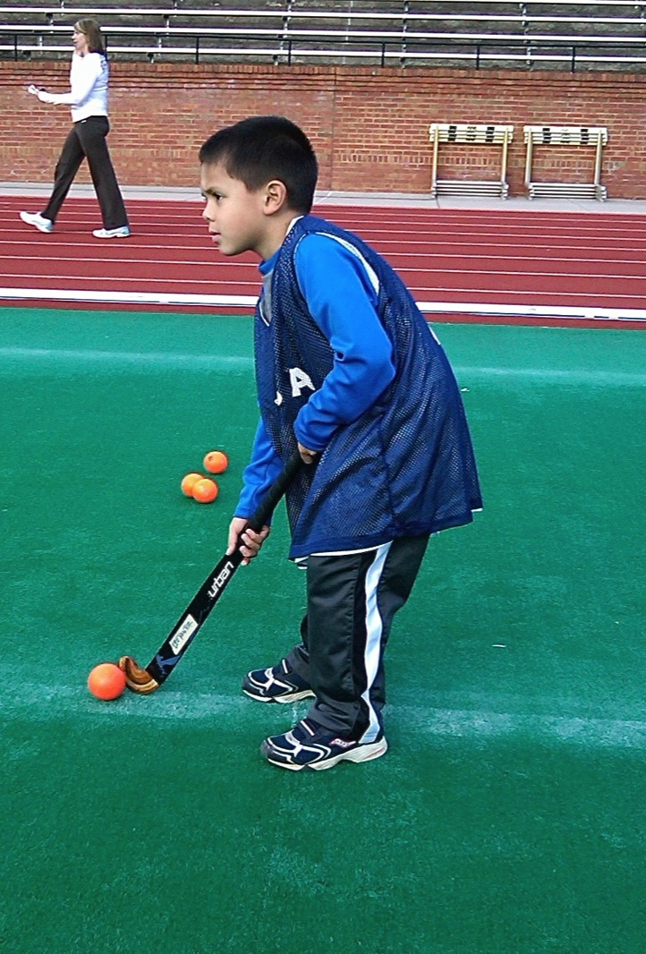
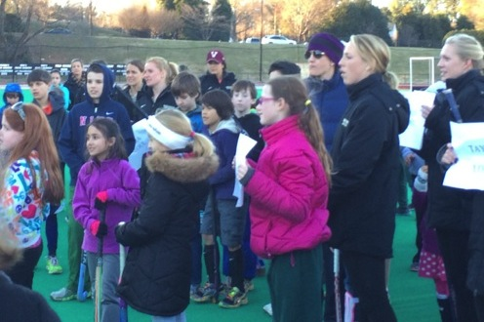
Costs and Benefits

Slide 17
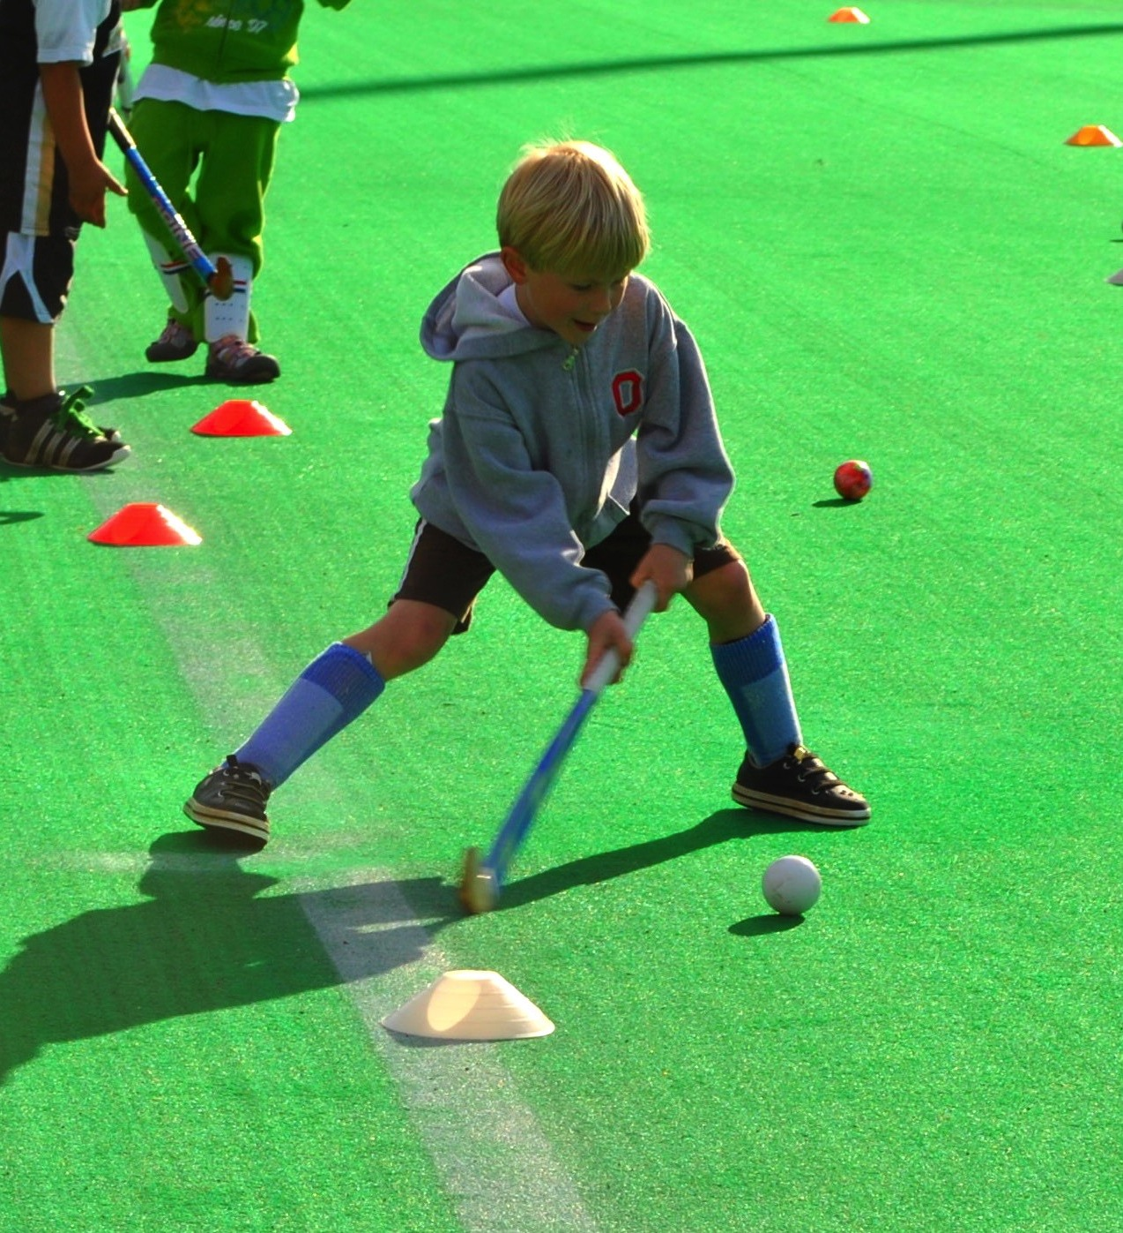
The costs to your program is time and enthusiasm.
Growth and exposure of our sport.
Health and physical benefits for our youth.
Behavioral benefits.
Personal development for your student athletes as well as the participants.
Community outreach for your institution.
Creates visibility for your coaches.

Slide 19
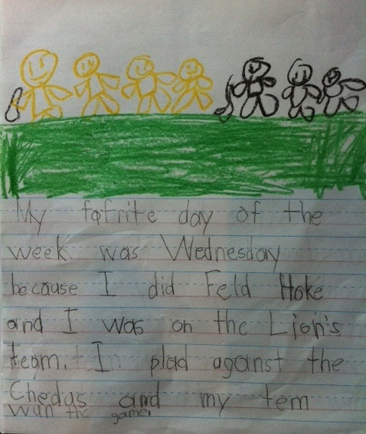
My favorite day of the week was Wednesday because I did Field Hockey and I was on the Lion’s team. I played against the Cheetahs and my team won the game.
Notes:
this is why we do it, are you kidding me??? this is what its all about.
My favorite day of the week was Wednesday because I did Field Hockey and I was on the Lion’s team. I played against the Cheetahs and my team won the game.

Slide 20
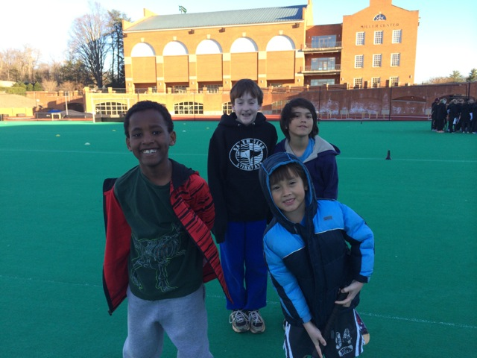

Slide 21
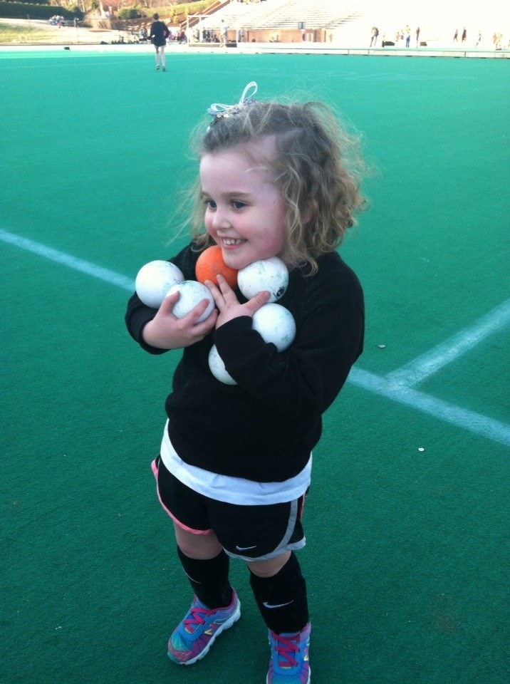

Slide 22
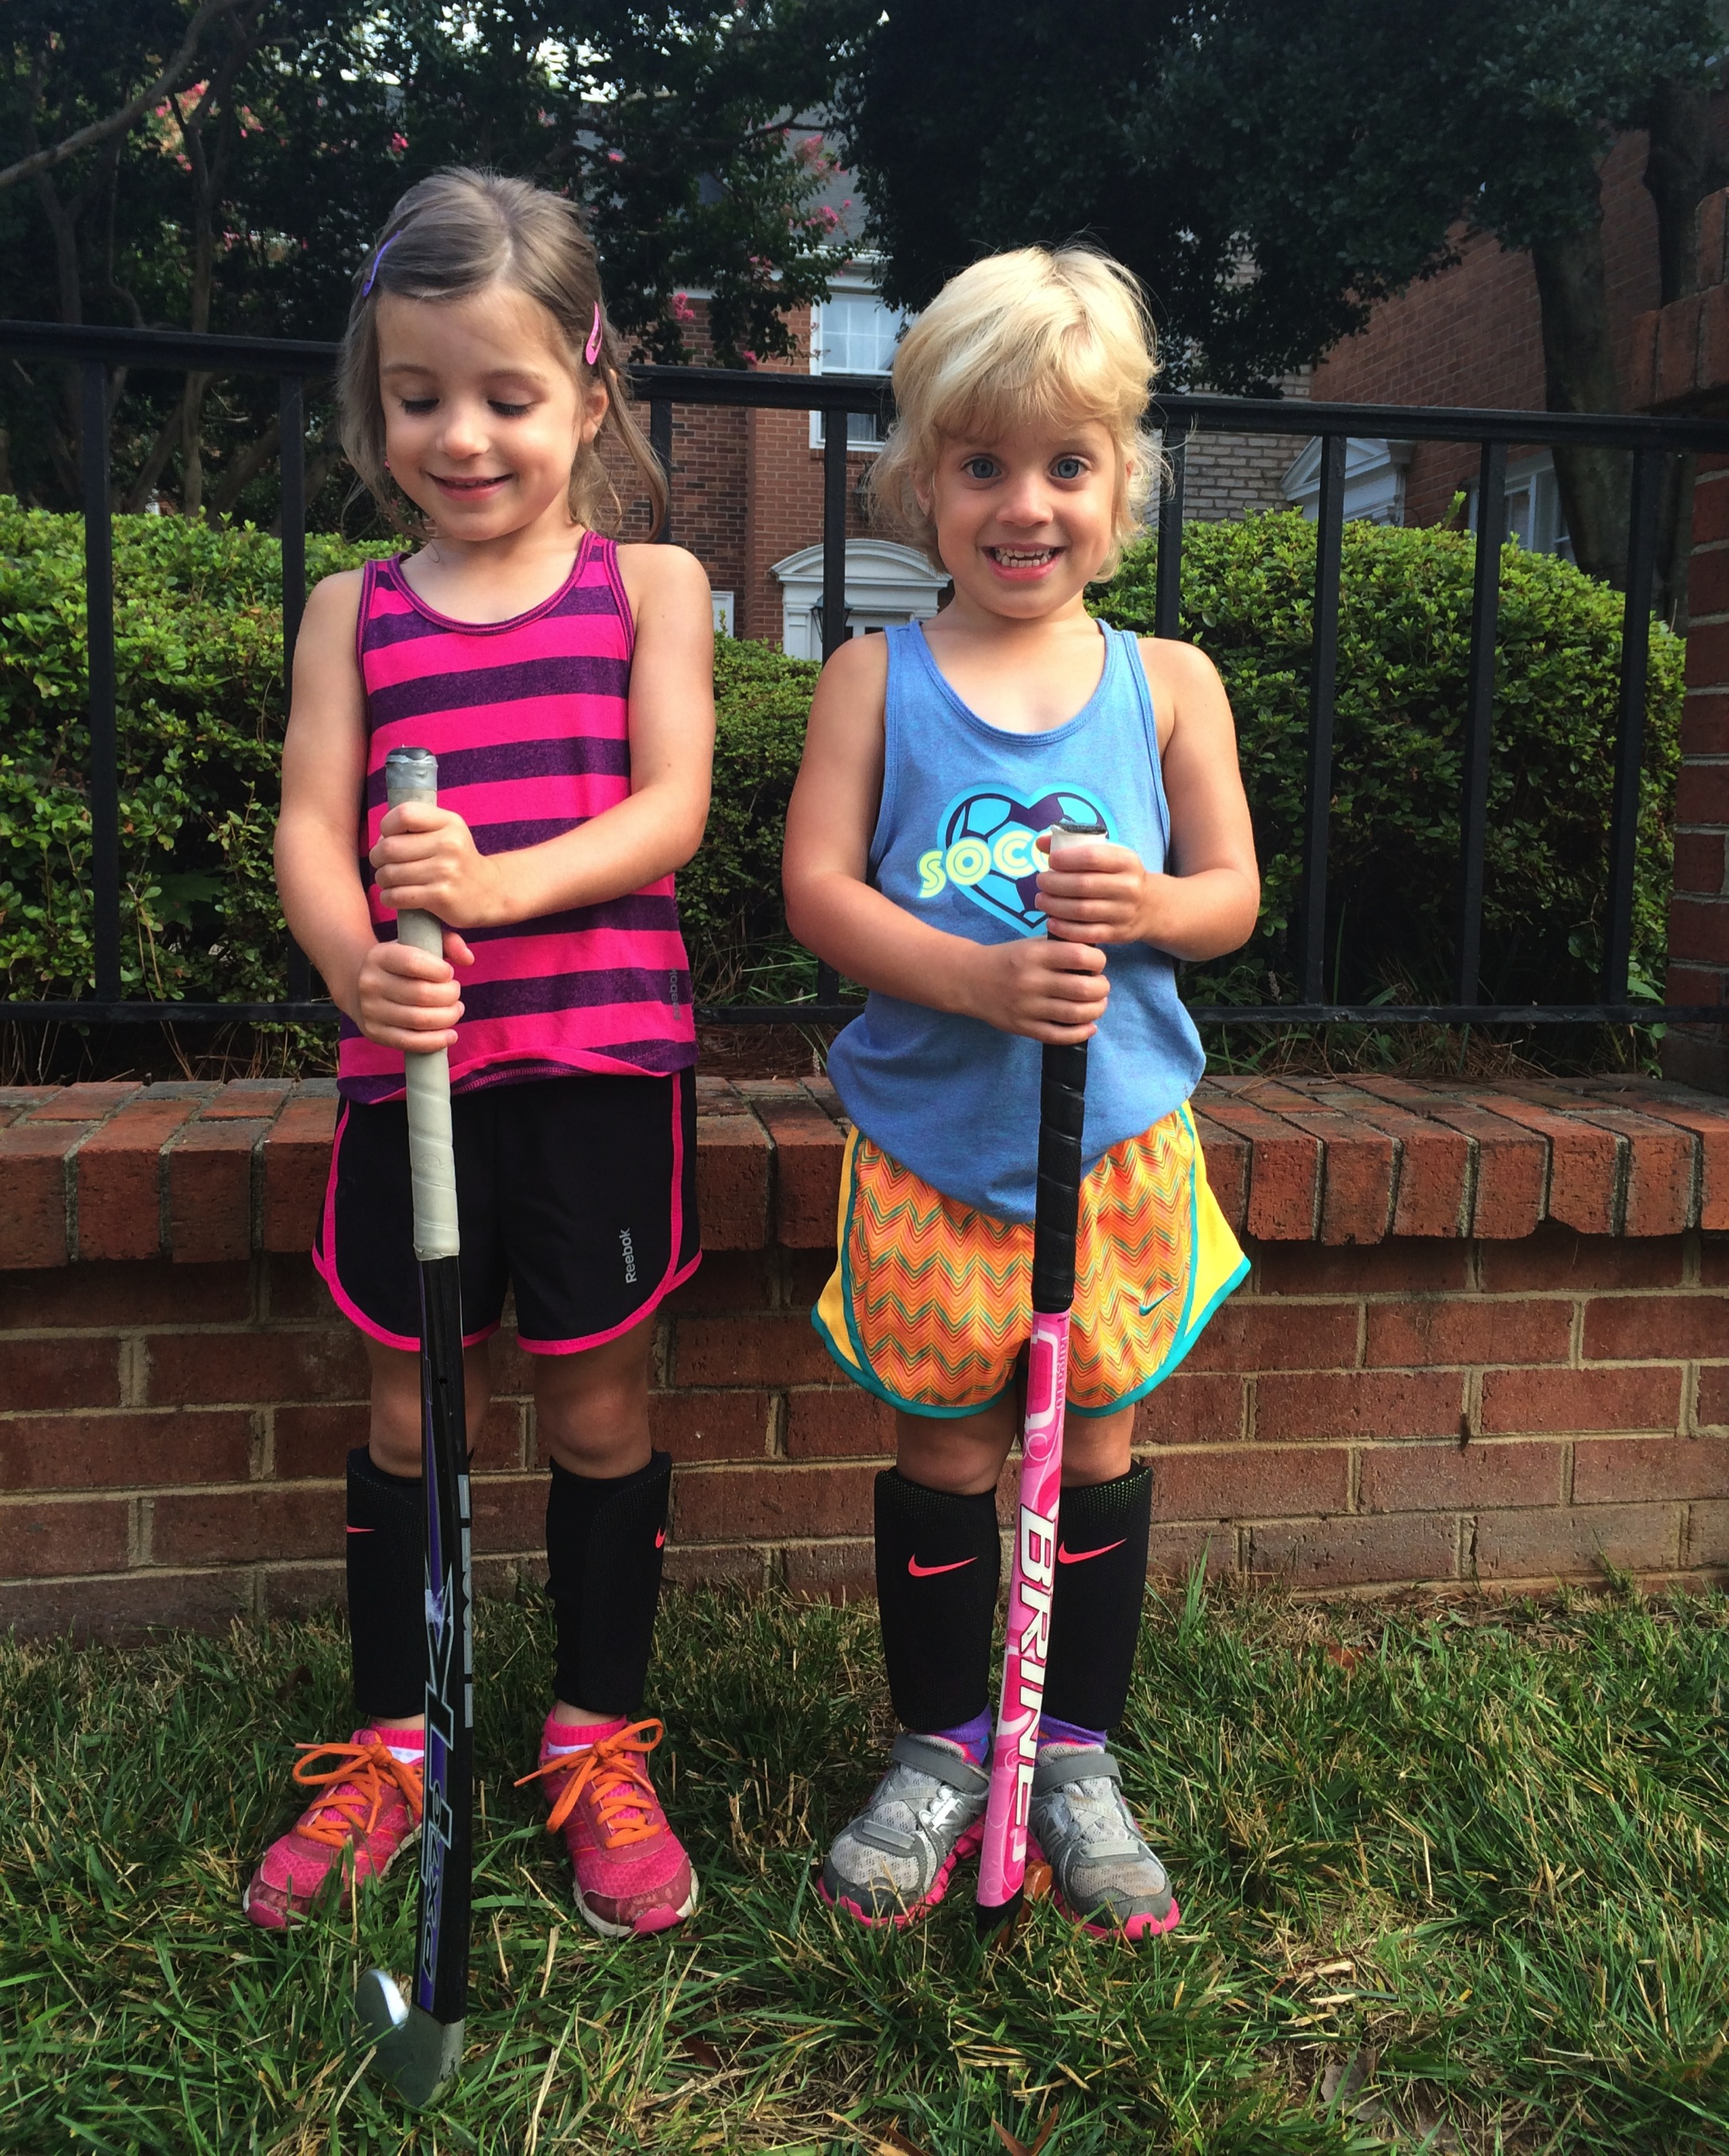

Slide 23
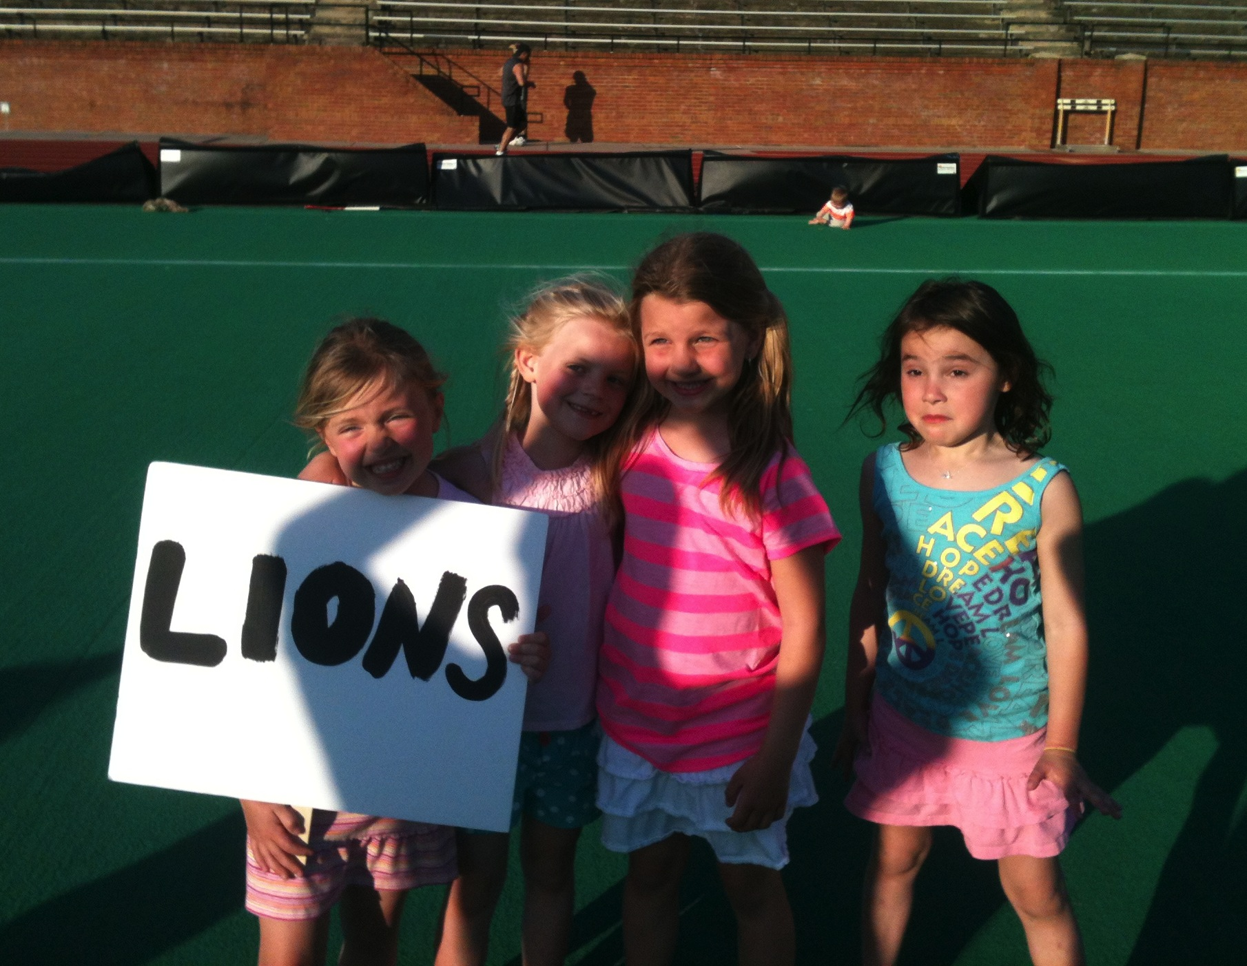

Slide 24
